Slide 1
Lecture 5 Label Aggregation: Matrix-Based Methods
Chien-Ju (CJ) Ho

Slide 2
Logistics: Bidding for Presentations
Check out the course schedule for the presentation slots:
Provide at least 3 bids by the end of today (hard deadline).
https://forms.gle/Mxtj1qLVG4QrZjwf9
You might want to glance over the papers of your bidding.
Bidding more bids is okay/encouraged
It might help decrease the chance you get assigned to slots outside of your bids.

Slide 3
Logistics: Bidding for Presentations
Additional notes
Enter the names of all members in your group
I’ll announce the assignment tomorrow
Manually solve the max-cover problem with the following objectives (in order)
Minimize # groups assigned to unpreferred slots
Prioritize groups with more bids
Random assignment at the end
I’ll fill in the slots if there are fewer groups than slots

Slide 4
Logistics: Bidding for Presentations
Current biddings
#1 | #2 | #3 | #4 | #5 | #6 | #7 | #8 | #9 | #10 | #11 | #12 | #13
Interested in Presenting |  |  | Interested in Presenting |  |  |  |  |  | Interested in Presenting
 | Interested in Presenting |  | Interested in Presenting |  |  |  | Interested in Presenting
 |  |  |  |  |  |  | Interested in Presenting | Interested in Presenting | Interested in Presenting | Interested in Presenting
 |  |  |  | Interested in Presenting | Interested in Presenting | Interested in Presenting |  | Interested in Presenting
 |  |  | Interested in Presenting |  |  |  | Interested in Presenting | Interested in Presenting |  |  | Interested in Presenting | Interested in Presenting
 |  | Interested in Presenting | Interested in Presenting | Interested in Presenting | Interested in Presenting | Interested in Presenting | Interested in Presenting
 |  |  |  |  |  |  | Interested in Presenting | Interested in Presenting | Interested in Presenting | Interested in Presenting

Slide 5
Logistics: Project Proposal
Due: September 23 (next Friday)
I have posted a list of example/past projects on the course website
Requirements:
Title, team members
1~2 paragraphs describing what you want to do
At least one relevant paper
Submission:
Submit on Gradescope.
One submission per group.
Need to include all teammates using the Gradescope interface.

Slide 6
Logistics: Assignments
Assignment 1 is due this Friday
Assignment 2
Posted on the course website
Due: September 30 (Friday)
Programming assignments
Implement and compare the performance of majority voting, EM, and SVD
You can use any programming language you like
You will be graded based on the report
You need to submit your codes
Used for plagiarism tests
Might check the codes if we have confusions/doubts on the reported results

Slide 7
Logistics: Assignment 2
Dataset:
https://sites.google.com/site/nlpannotations. (rte.standardized.tsv)
Recognizing Textual Entailment (RTE) task
800 tasks; 164 workers; 10 labels per task
Task: Whether the first sentence implies the second hypothesis

Slide 8
Logistics: Assignment 2
You might want to convert the labels/gold to {+1,-1}
Worker Label
Ground Truth
(only used to evaluate
the aggregation algorithm)
Ignore this column
Worker ID
Task ID

Slide 9
Logistics: Assignment 2
Requirements
Create random subsampled datasets:
Original: 800 tasks; 164 workers; 10 labels per task
Randomly sub-sample the labels, such that each task has k labels
k=1, 2, 3, …, 10
Implement majority voting, EM (simple version as in the discussion session), SVD
Calculate the error (ratio of tasks the algorithms make wrong predictions)
Compare the performance of algorithms
Generate a figure with x-axis being k, y-axis being error
Plot 3 curves, each corresponding to an algorithm
Offer brief discussion
”Expand” the dataset to see the performance of SVD with larger k

Slide 10
Quick Recap

Slide 11
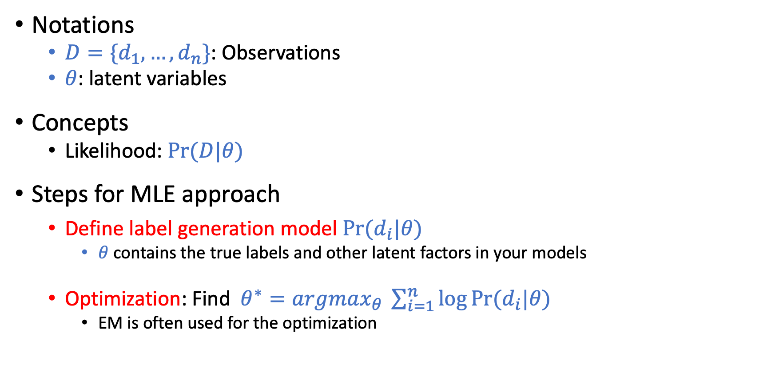
EM-Based Approach
Notations
$D=\{d_{1},…,d_{n}\}$: Observations
$θ$: latent variables
Concepts
Likelihood: $Pr⁡(D|θ)$
Steps for MLE approach
Define label generation model $Pr⁡(d_{i}|θ)$
$θ$ contains the true labels and other latent factors in your models
Optimization: Find $θ^{∗}=argmax_{θ} \sum_{i=1}^{n}{\log{Pr⁡(d_{i}|θ)}}$
EM is often used for the optimization

Slide 12
EM-Based Approach
Connection to supervised learning
Model of the labeling process: Hypothesis set / Loss Function
EM: an algorithm to find a hypothesis within the set that minimizes the error
Pros
Empirically performs well
A generic framework
There is a HUGE amount of research along this line, with different models of label generation
Cons
EM only attempts to find the local optimal of the objective function
Lack of theoretical guarantees on the final performance
Are we just getting lucky?

Slide 13
Today’s Lecture

Slide 14
Label Aggregation
 | Task 1 | Task 2 | Task 3 | Task 4 | …
Worker 1 | 1 | -1 | 1 | 1
Worker 2 | 1 | -1 | -1 | -1
Worker 3 | -1 | 1 | -1 | 1
Worker 4 | 1 | -1 | 1 | 1
…
?
?
?
?
Goal: Infer the true label of each task
The given data is represented as a matrix

Slide 15
Let’s Look at Another Similar Problem
Movie recommendation
 | Movie 1 | Movie 2 | Movie 3 | Movie 4 | Movie 5 | Movie 6
Alice | 5 | 4 |  | 1
Bob | 4 |  |  | 2 | 5
Charlie | 1 |  | 4 |  | 2
David |  | 3 | 2 |  |  | 4
…
Warmup Discussion:
Which movie will you recommend to Alice? Why?

Slide 16
Collaborative Filtering
 | Movie 1 | Movie 2 | Movie 3 | Movie 4 | Movie 5 | Movie 6
Alice | 5 | 4 |  | 1
Bob | 4 |  |  | 2 | 5
Charlie | 1 |  | 4 |  | 2
David |  | 3 | 2 |  |  | 4
…
Bob is probably most similar to Alice
User-based collaborative filtering
Examine users’ rating vector
Alice and Bob seem to have similar tastes
Bob likes Movie 5
Alice probably also likes Movie 5
We can also calculate similarities among users, and weight their opinions accordingly

Slide 17
Collaborative Filtering
 | Movie 1 | Movie 2 | Movie 3 | Movie 4 | Movie 5 | Movie 6
Alice | 5 | 4 |  | 1
Bob | 4 |  |  | 2 | 5
Charlie | 1 |  | 4 |  | 2
David |  | 3 | 2 |  |  | 4
…
Item-based collaborative filtering
Examine items’ rating vectors
People who like/hate Movie 1 seem to like/hate Movie 5 as well
Since Alice likes Movie 1, she might also like Movie 5

Slide 18
Discussions and Intuitions
Properties of the approach
Simple and interpretable
Cold-start and data sparsity problem (won’t discuss much in this lecture)
Key intuitions for collaborative filtering to work
A big number of ratings are controlled by a small number of parameters
You probably can see why this is related to crowdsourcing already
Low rank matrix approximation
A principled method to utilize the above intuition
 | Movie 1 | Movie 2 | Movie 3 | Movie 4 | Movie 5 | Movie 6
Alice | 5 | 4 |  | 1
Bob | 4 |  |  | 2 | 5
Charlie | 1 |  | 4 |  | 2
David |  | 3 | 2 |  |  | 4
…

Slide 19
A very short intro to Low rank matrix approximation

Slide 20
Rank of a Matrix
Matrix Rank
# linearly independent row (or column) vectors in a matrix
Example
What does low rank matrix imply?
Rank: 2
Rank: 2

Slide 21
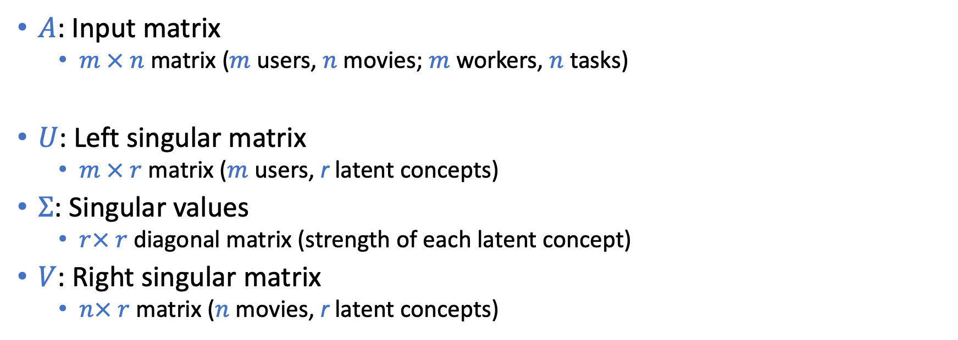
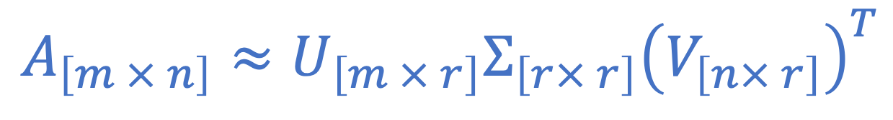
Singular Value Decomposition (SVD)
$$A_{\left[m × n\right]}≈U_{\left[m × r\right]}Σ_{\left[r× r\right]}{\left(V_{\left[n× r\right]}\right)}^{T}$$
$A$: Input matrix
$m × n$ matrix ($m$ users, $n$ movies; $m$ workers, $n$ tasks)
$U$: Left singular matrix
$m × r$ matrix ($m$ users, r latent concepts)
$Σ$: Singular values
$r× r$ diagonal matrix (strength of each latent concept)
$V$: Right singular matrix
$n× r$ matrix ($n$ movies, r latent concepts)
(Technically, the SVD definition here is slightly different from standard definition, but we can get this one with some discussion on matrix ranks.)
(See the lecture notes by Tim Roughgarden for more details.)

Slide 22
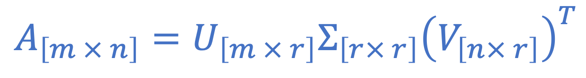

Singular Value Decomposition (SVD)
It is always possible to make such decomposition exactly equal (if we don’t put any restrictions on the rank r)
Low rank matrix decomposition
Can we approximate A with this decomposition with small rank r
$$A_{\left[m × n\right]}=U_{\left[m × r\right]}Σ_{\left[r× r\right]}{\left(V_{\left[n× r\right]}\right)}^{T}$$
$$A_{\left[m × n\right]}≈U_{[m × r]}Σ_{\left[r× r\right]}{\left(V_{\left[n× r\right]}\right)}^{T}$$
A dimension reduction technique; Reduce the number of parameters (and therefore requires less data to learn)

Slide 23
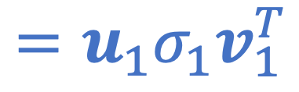
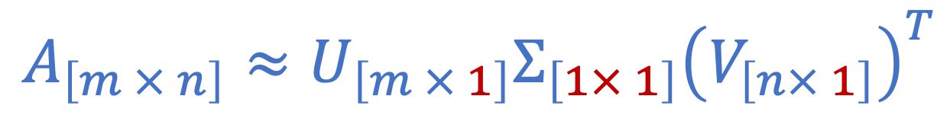
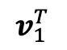
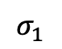
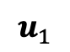
Rank 1 Approximation
$$A_{\left[m × n\right]}≈U_{\left[m × 1\right]}Σ_{\left[1× 1\right]}{\left(V_{\left[n× 1\right]}\right)}^{T}$$
$$=u_{1}σ_{1}v_{1}^{T}$$
n
$$u_{1}$$
$$σ_{1}$$
$$v_{1}^{T}$$
≈
A
Top right singular vector
m
Singular value
Top left singular vector

Slide 24
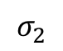

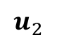
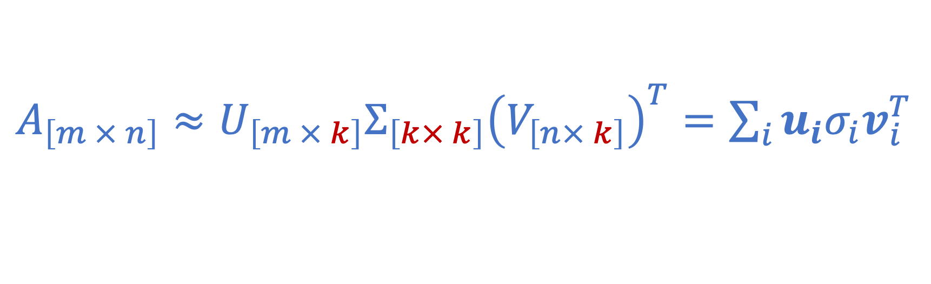
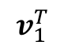
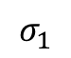
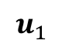
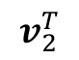
Rank k Approximation
$A_{\left[m × n\right]}≈U_{\left[m × k\right]}Σ_{\left[k× k\right]}{\left(V_{\left[n× k\right]}\right)}^{T}=\sum_{i}{u_{i}σ_{i}v_{i}^{T}}$
n
n
$$u_{1}$$
$$σ_{1}$$
$$v_{1}^{T}$$
$$u_{2}$$
$$σ_{2}$$
$$v_{2}^{T}$$
A
≈
Σ
V^{T}
=
m
m
+
U

Slide 25
Rank k Approximation
$A_{\left[m × n\right]}≈U_{\left[m × k\right]}Σ_{\left[k× k\right]}{\left(V_{\left[n× k\right]}\right)}^{T}=\sum_{i}{u_{i}σ_{i}v_{i}^{T}}$
n
n
$$u_{1}$$
$$σ_{1}$$
$$v_{1}^{T}$$
$$u_{2}$$
$$σ_{2}$$
$$v_{2}^{T}$$
A
≈
Σ
V^{T}
=
m
m
+
U

Slide 26
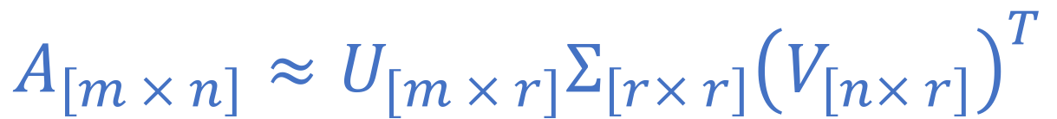
Movie Recommendation Example
Matrix
Alien
Serenity
Casablanca
Amelie
$$A_{\left[m × n\right]}≈U_{[m × r]}Σ_{\left[r× r\right]}{\left(V_{\left[n× r\right]}\right)}^{T}$$
1 1 1 0 0
3 3 3 0 0
4 4 4 0 0
5 5 5 0 0
0 2 0 4 4
0 0 0 5 5
0 1 0 2 2
0.13 0.02 -0.01
0.41 0.07 -0.03
0.55 0.09 -0.04
0.68 0.11 -0.05
0.15 -0.59 0.65
0.07 -0.73 -0.67
0.07 -0.29 0.32
12.4 0 0
0 9.5 0
0 0 1.3
=
x
x
0.56 0.59 0.56 0.09 0.09
0.12 -0.02 0.12 -0.69 -0.69
0.40 -0.80 0.40 0.09 0.09

Slide 27
Movie Recommendation Example
$$A_{\left[m × n\right]}≈U_{[m × r]}Σ_{\left[r× r\right]}{\left(V_{\left[n× r\right]}\right)}^{T}$$
Matrix
Alien
Serenity
Casablanca
Amelie
SciFi-concept
Romance-concept
“strength” of the SciFi-concept
1 1 1 0 0
3 3 3 0 0
4 4 4 0 0
5 5 5 0 0
0 2 0 4 4
0 0 0 5 5
0 1 0 2 2
0.13 0.02 -0.01
0.41 0.07 -0.03
0.55 0.09 -0.04
0.68 0.11 -0.05
0.15 -0.59 0.65
0.07 -0.73 -0.67
0.07 -0.29 0.32
12.4 0 0
0 9.5 0
0 0 1.3
=
x
x
0.56 0.59 0.56 0.09 0.09
0.12 -0.02 0.12 -0.69 -0.69
0.40 -0.80 0.40 0.09 0.09
SciFi-concept
Romance-concept

Slide 28
Netflix Challenge
$1 million award for people beating their algorithm by 10%
Simply implementing SVD already beats the algorithm Netflix was using…
The winning team uses an ensemble of many methods
SVD is one major component

Slide 29
How to Perform SVD
Should be covered in linear algebra class….
Most likely, you will just use an existing library

Slide 30
Let’s (finally) get back to label aggregation
Who moderates the moderators? Crowdsourcing abuse detection in user-generated content. Ghosh, Kale, and McAfee. EC 2011.

Slide 31

User Generated Content
It’s a common practice to use user ratings to determine whether a content is good or not
When a content receives a bad rating
is the content bad, or
is the rating bad?
Given users ratings, how to decide content quality
This is a crowdsourcing label aggregation problem. With each rating being a label provided by a worker

Slide 32

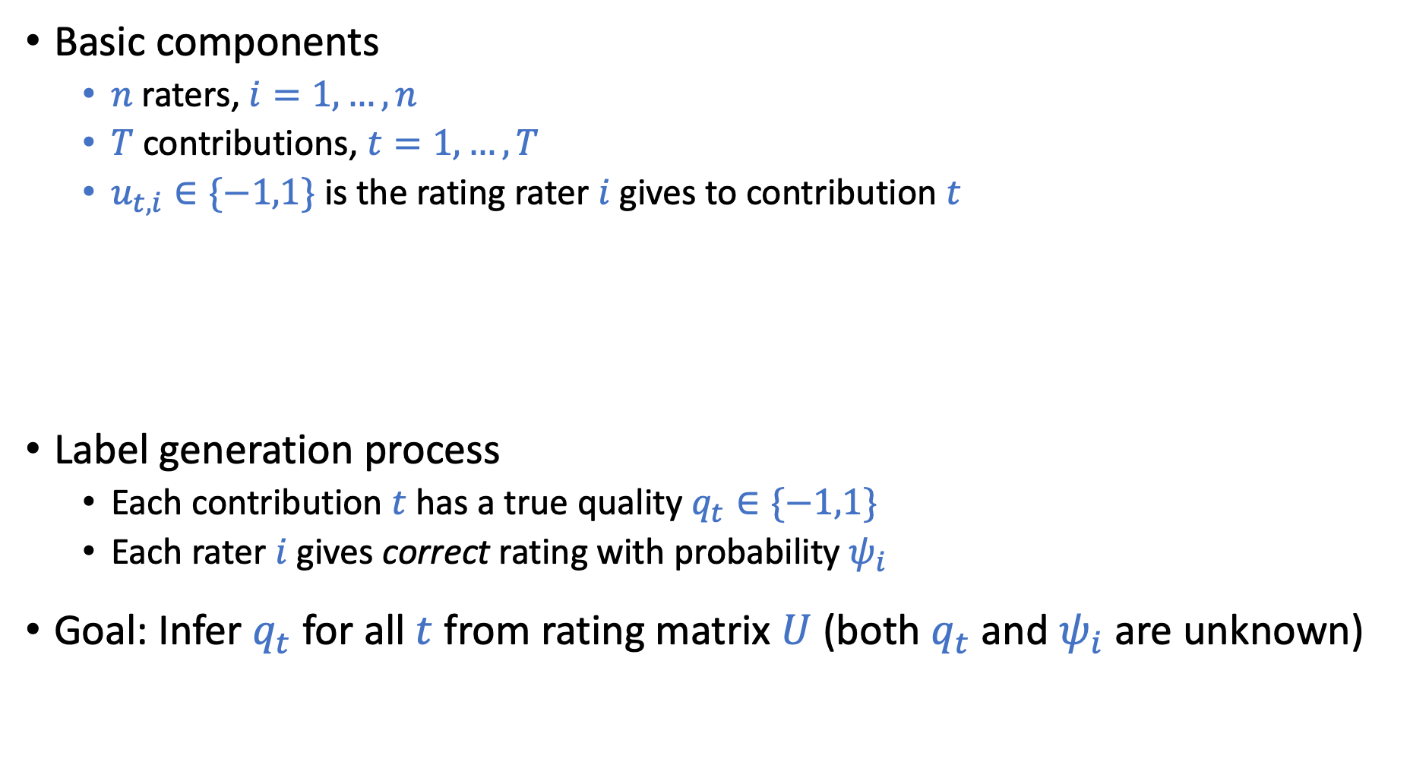
Model
NOTE:
1. The notations here are different from the previous slides about SVD.
2. The matrix also uses a different representation compared with the movie rating examples. In movie rating, each row is a user’s ratings. Here, each column is a rater’s ratings.
Basic components
$n$ raters, $i=1,…,n$
$T$ contributions, $t=1,…,T$
$u_{t,i}∈\{−1,1\}$ is the rating rater $i$ gives to contribution $t$
Label generation process
Each contribution $t$has a true quality $q_{t}∈\{−1,1\}$
Each rater $i$ gives correct rating with probability $ψ_{i}$
Goal: Infer $q_{t}$ for all $t$ from rating matrix $U$ (both $q_{t}$ and $ψ_{i}$ are unknown)
 | Rater 1 | Rater 2 | Rater 3 | Rater 4 | …
Contribution 1 | 1 | -1 | -1 | 1
Contribution 2 | -1 | 1 | 1 | -1
Contribution 3 | 1 | 1 | -1 | 1
…
$$U$$

Slide 33
The Goal Seems Different from Movie Recommendation
In movie recommendation
Goal: Fill in the empty ratings (and recommend the movie with highest one)
In this paper
Assumption: all ratings are given
Goal: Infer the latent variable (true quality)
Connection: Low rank approximation of the rating matrix
 | Rater 1 | Rater 2 | Rater 3 | Rater 4 | …
Contribution 1 | 1 | -1 | -1 | 1
Contribution 2 | -1 | 1 | 1 | -1
Contribution 3 | 1 | 1 | -1 | 1
…

Slide 34
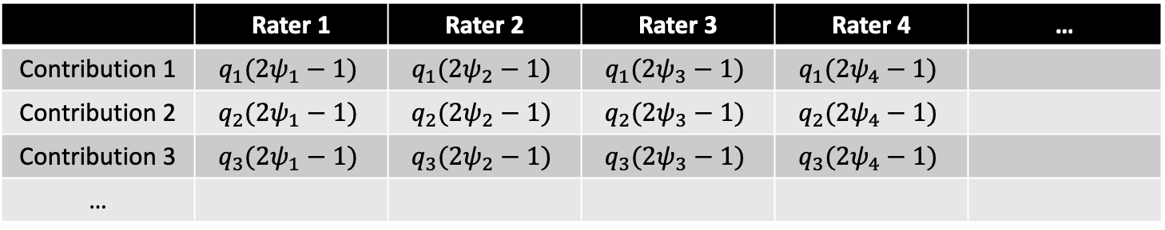
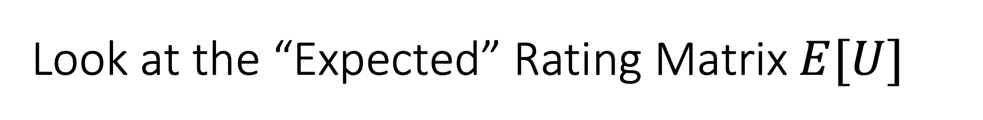
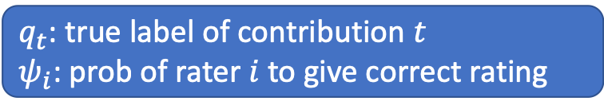
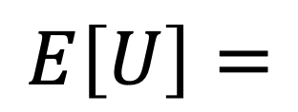
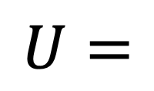
Look at the “Expected” Rating Matrix$E[U]$
 | Rater 1 | Rater 2 | Rater 3 | Rater 4 | …
Contribution 1 | 1 | -1 | -1 | 1
Contribution 2 | -1 | 1 | 1 | -1
Contribution 3 | 1 | 1 | -1 | 1
…
$$U=$$
 | Rater 1 | Rater 2 | Rater 3 | Rater 4 | …
Contribution 1 | $$q_{1}(2ψ_{1}−1)$$ | $$q_{1}(2ψ_{2}−1)$$ | $$q_{1}(2ψ_{3}−1)$$ | $$q_{1}(2ψ_{4}−1)$$
Contribution 2 | $$q_{2}(2ψ_{1}−1)$$ | $$q_{2}(2ψ_{2}−1)$$ | $$q_{2}(2ψ_{3}−1)$$ | $$q_{2}(2ψ_{4}−1)$$
Contribution 3 | $$q_{3}(2ψ_{1}−1)$$ | $$q_{3}(2ψ_{2}−1)$$ | $$q_{3}(2ψ_{3}−1)$$ | $$q_{3}(2ψ_{4}−1)$$
…
$$E\left[U\right]=$$
$q_{t}$: true label of contribution $t$
$ψ_{i}$: prob of rater $i$to give correct rating

Slide 35
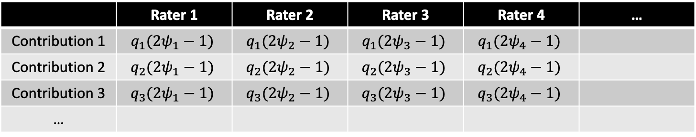
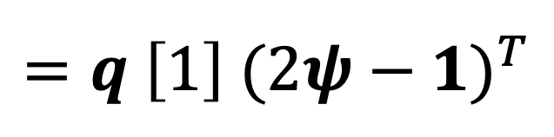
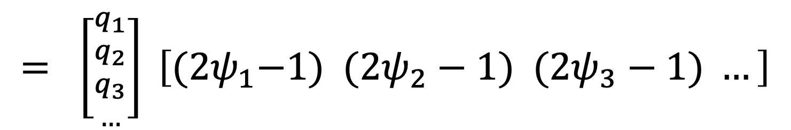
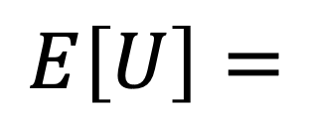
Look at the “Expected” Rating Matrix$E[U]$
 | Rater 1 | Rater 2 | Rater 3 | Rater 4 | …
Contribution 1 | $$q_{1}(2ψ_{1}−1)$$ | $$q_{1}(2ψ_{2}−1)$$ | $$q_{1}(2ψ_{3}−1)$$ | $$q_{1}(2ψ_{4}−1)$$
Contribution 2 | $$q_{2}(2ψ_{1}−1)$$ | $$q_{2}(2ψ_{2}−1)$$ | $$q_{2}(2ψ_{3}−1)$$ | $$q_{2}(2ψ_{4}−1)$$
Contribution 3 | $$q_{3}(2ψ_{1}−1)$$ | $$q_{3}(2ψ_{2}−1)$$ | $$q_{3}(2ψ_{3}−1)$$ | $$q_{3}(2ψ_{4}−1)$$
…
$$E\left[U\right]=$$
$$= \left[{{q_{1} \atop q_{2}} \atop {q_{3} \atop …}}\right] \left[{(2ψ}_{1}−1) (2ψ_{2}−1) (2ψ_{3}−1) …\right]$$
$$=q \left[1\right]{ (2ψ−1)}^{T}$$
This is the exact singular value decomposition with rank 1

Slide 36
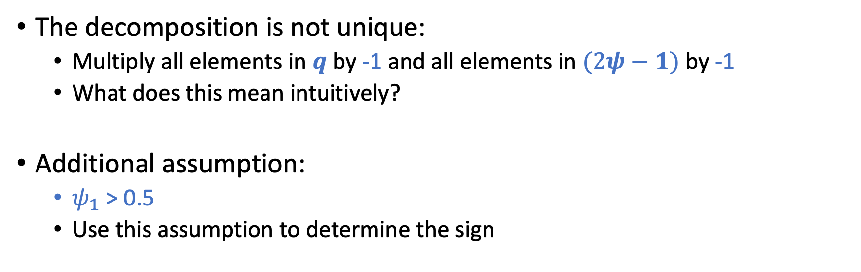
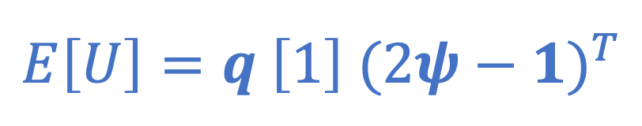
Look at the “Expected” Rating Matrix$E[U]$
$$E\left[U\right]=q \left[1\right]{ (2ψ−1)}^{T}$$
The decomposition is not unique:
Multiply all elements in $q$ by -1 and all elements in $(2ψ−1)$ by -1
What does this mean intuitively?
Additional assumption:
$ψ_{1}$ > 0.5
Use this assumption to determine the sign

Slide 37
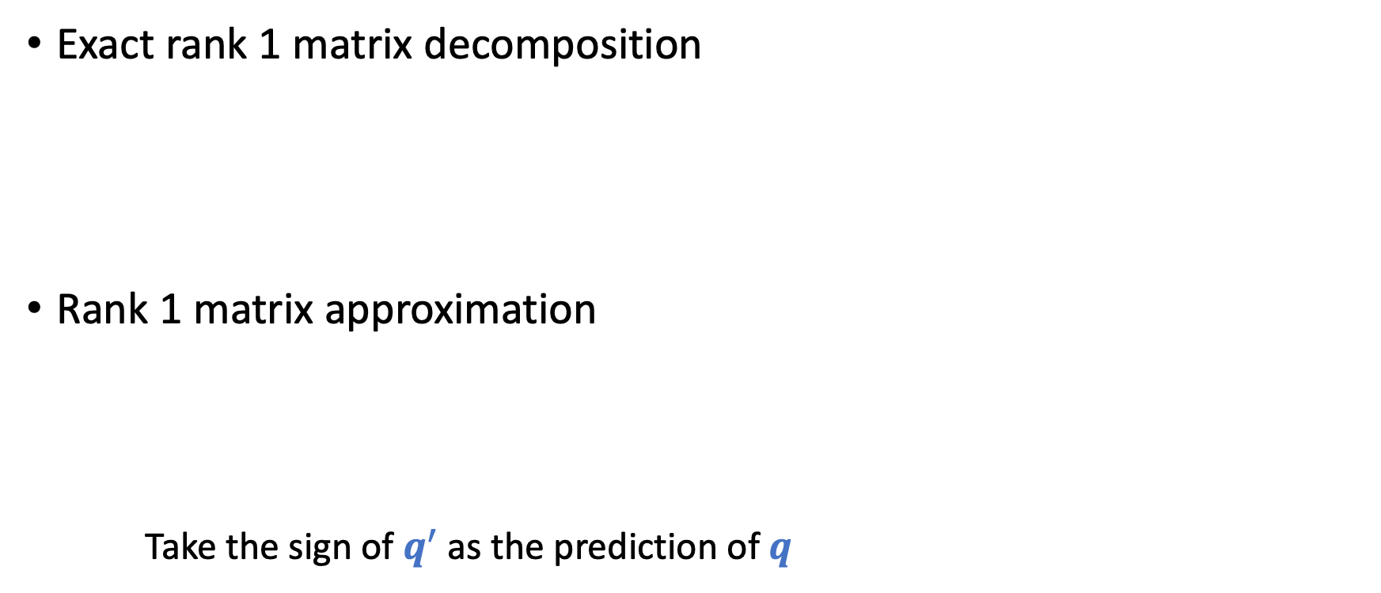


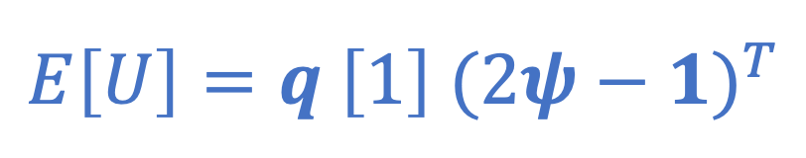
From $E[U]$ to $U$
Exact rank 1 matrix decomposition
Rank 1 matrix approximation
Take the sign of $q^{′}$ as the prediction of $q$
$$E\left[U\right]=q \left[1\right]{ (2ψ−1)}^{T}$$
$$U ≈q′ \left[1\right]{ (2ψ′−1)}^{T}$$

Slide 38
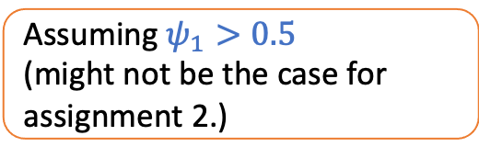
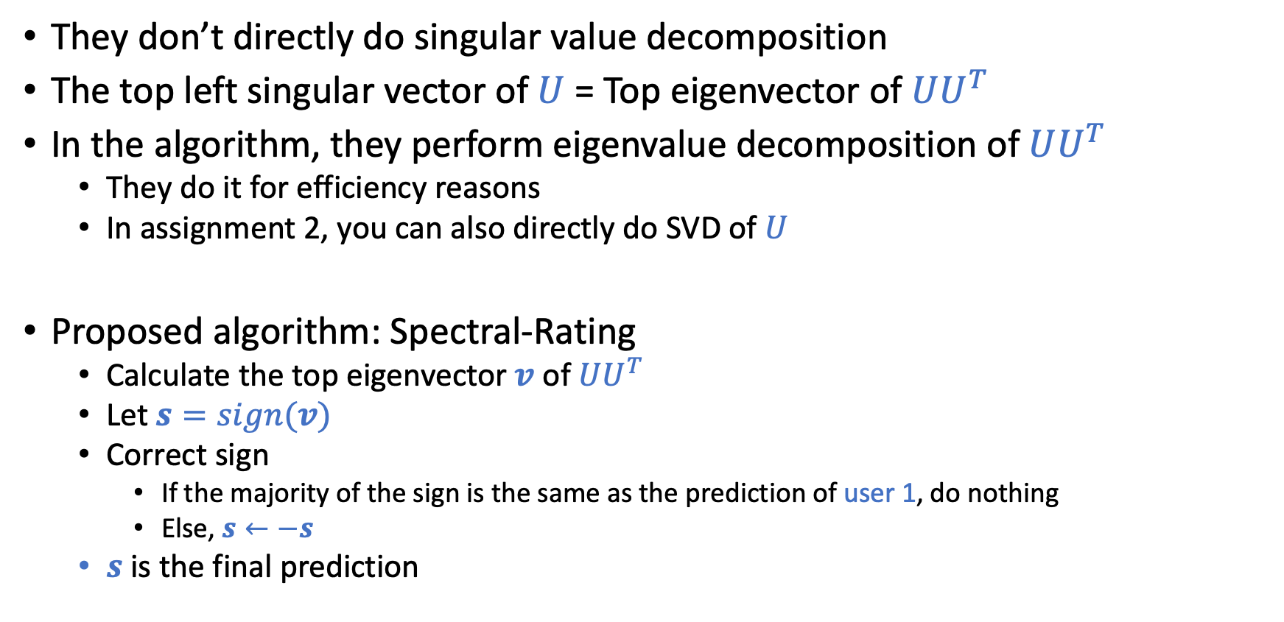
More Details
They don’t directly do singular value decomposition
The top left singular vector of $U$= Top eigenvector of $UU^{T}$
In the algorithm, they perform eigenvalue decomposition of $UU^{T}$
They do it for efficiency reasons
In assignment 2, you can also directly do SVD of $U$
Proposed algorithm: Spectral-Rating
Calculate the top eigenvector $v$ of $UU^{T}$
Let $s=sign(v)$
Correct sign
If the majority of the sign is the same as the prediction of user 1, do nothing
Else, $s←−s$
$s$ is the final prediction
Assuming $ψ_{1}>0.5$
(might not be the case for assignment 2.)

Slide 39
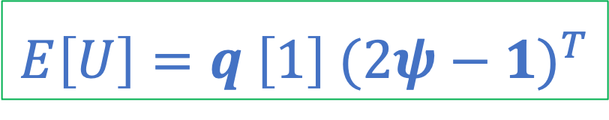
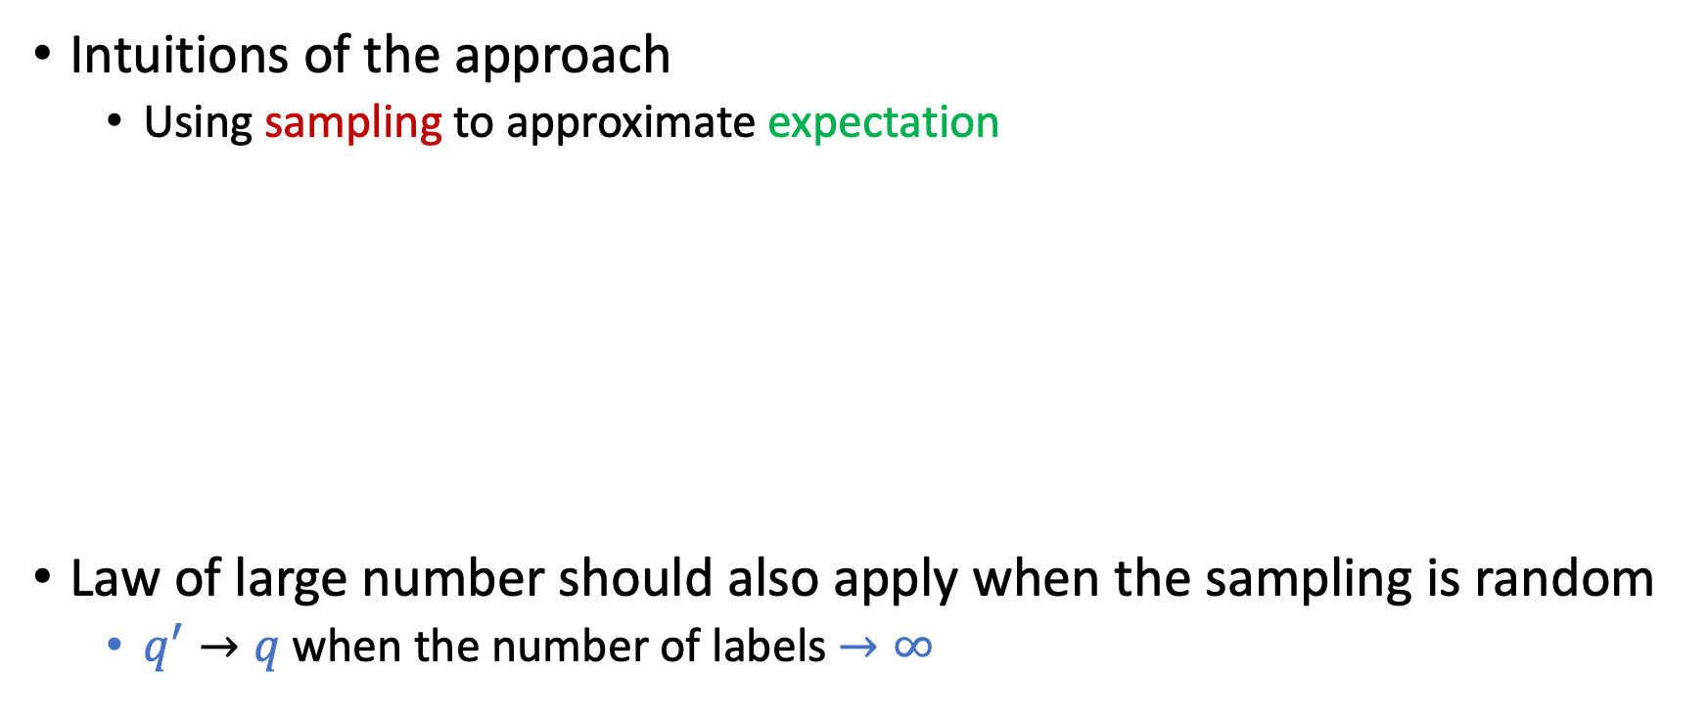
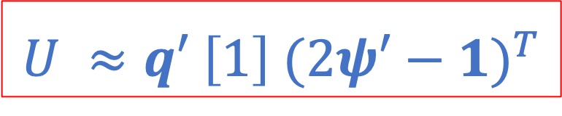
What Theoretical Guarantees Can We Get?
Intuitions of the approach
Using sampling to approximate expectation
Law of large number should also apply when the sampling is random
$q^{′}→q$when the number of labels $→∞$
$$U ≈q′ \left[1\right]{ (2ψ′−1)}^{T}$$
$$E\left[U\right]=q \left[1\right]{ (2ψ−1)}^{T}$$

Slide 40
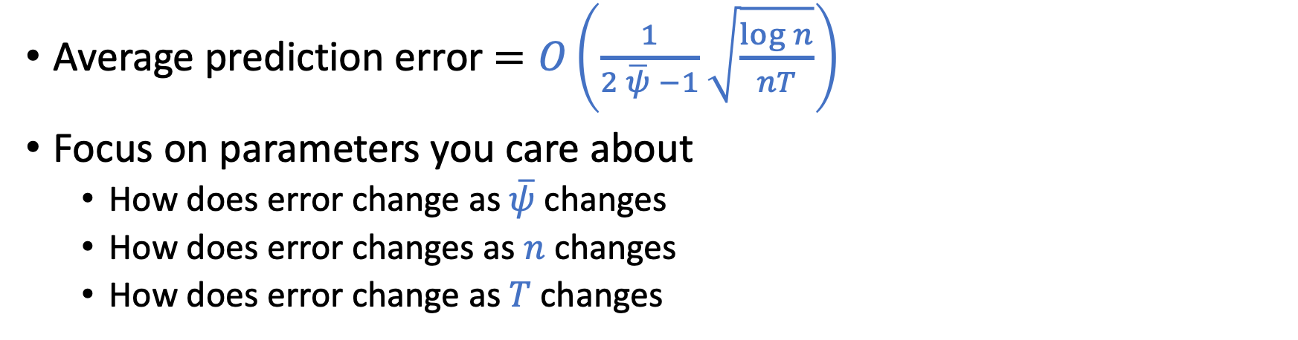
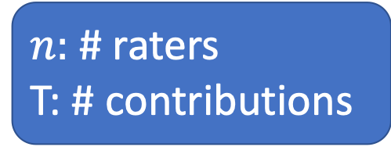
Utilizing the Matrix form of Hoeffding’s Inequality
$n:$ # raters
T: # contributions
Average prediction error $=O\left(\frac{1}{2 \overline{ψ} −1}\sqrt{\frac{\log{n}}{nT}}\right)$
Focus on parameters you care about
How does error change as $\overline{ψ}$ changes
How does error changes as $n$ changes
How does error change as $T$ changes

Slide 41
Extensions
Not every rater rates every contribution
 | Rater 1 | Rater 2 | Rater 3 | Rater 4 | …
Contribution 1 | 1 |  | -1 | 1
Contribution 2 | -1 | 1
Contribution 3 |  |  | -1 | 1
…

Slide 42
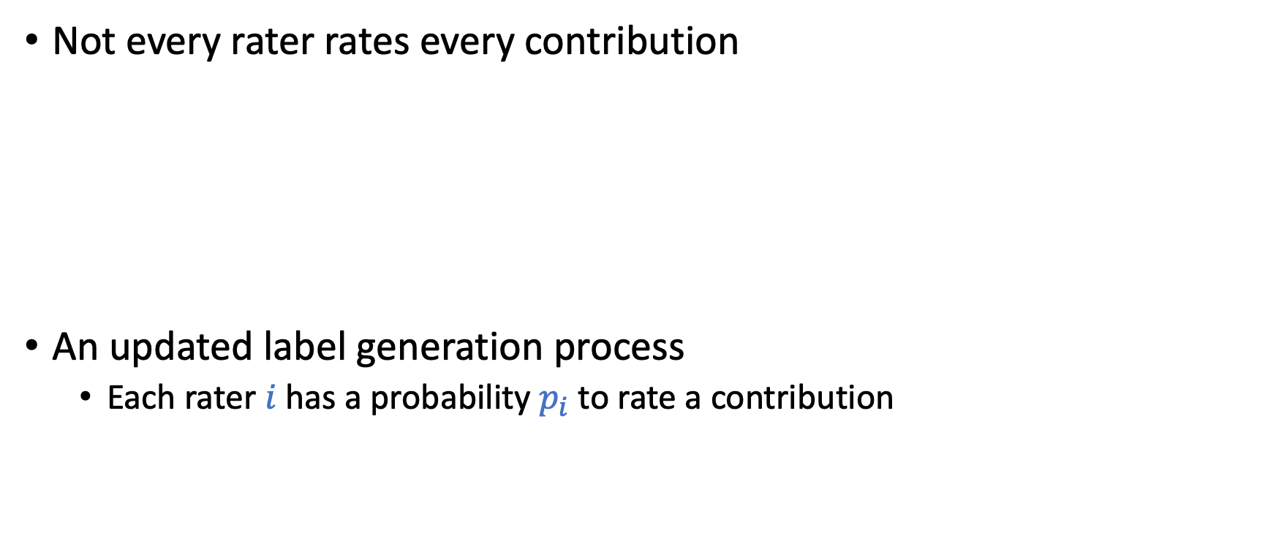
Extensions
Not every rater rates every contribution
An updated label generation process
Each rater $i$has a probability $p_{i}$ to rate a contribution
 | Rater 1 | Rater 2 | Rater 3 | Rater 4 | …
Contribution 1 | 1 | 0 | -1 | 1
Contribution 2 | -1 | 1 | 0 | 0
Contribution 3 | 0 | 0 | -1 | 1
…
Is this a reasonable model?
Why do you think we need this model?

Slide 43
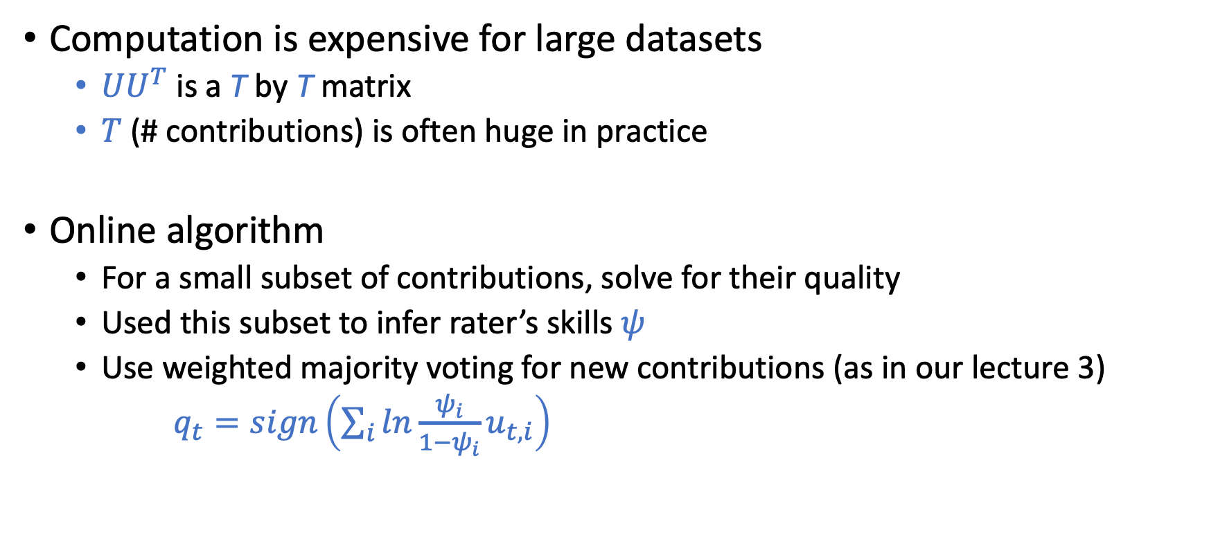
Extensions
Computation is expensive for large datasets
$UU^{T}$ is a T by T matrix
$T$ (# contributions) is often huge in practice
Online algorithm
For a small subset of contributions, solve for their quality
Used this subset to infer rater’s skills $ψ$
Use weighted majority voting for new contributions (as in our lecture 3)
$q_{t}=sign\left(\sum_{i}{ln\frac{ψ_{i}}{1−ψ_{i}}u_{t,i}}\right)$

Slide 44
Extensions
Algorithm robustness against rater manipulations
Change their “skills” to influence the algorithm outcome
Change their labeling strategy (not randomized) to influence the algorithm outcome
Collude with other raters to influence the outcome for a particular contribution
The results are “robust” if the ratio of manipulations is not large
What if manipulations are prevalent
Learning with the presence of strategic behavior
We will discuss more on this in the lecture of Nov 15

Slide 45
Discussion
General thoughts about this work.
What are your thoughts on the manipulation issue? What are the potential scenarios for manipulations to happen? Are there any way to fight again manipulations?
What kind of research do you like? Why?
Empirically oriented: Design new algorithms and examine them on some datasets. No theoretical guarantees.
Theoretically oriented: Make assumptions on the target problems. Design algorithms and prove theoretical properties of the algorithms.

Slide 46
Learning with the Presence of Strategic Behavior
More on the lecture of Nov 15

Slide 47
Example: Spam Classification

Slide 48
Example: Spam Classification

Slide 49
Example: Spam Classification

Slide 50
Goodhart’s law:
“If a measure becomes the public’s goal, it is no longer a good measure.”

Slide 51
What We Learned So Far
EM-based methods
Empirically performs well
Relatively computationally efficient
No theoretical guarantee
Matrix-based methods
Comes with theoretical guarantee
Computationally expensive
Can we achieve the best of both worlds?

Slide 52
Spectral Methods Meet EM
Spectral Methods Meet EM: A Provably Optimal Algorithm for Crowdsourcing. Zhang et al. JMLR 2016.
The main issue for EM: Might converge to local optimum

Slide 53
Spectral Methods Meet EM
Key idea:
Estimate the “confusion matrix” from data
Using the estimation as the initial point for running the EM algorithm
Key results
Given this fine-tuned starting point, with high probability, EM can achieve global optimal

